Slide 1
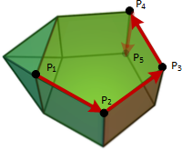
Outline
Theorem : If a LP problem in standard form has an optimal solution, then there exists a basic feasible solution that is optimal.
▶ The simplex method is based on this fact.
▶ It searches for an optimal solution by moving from one basic feasible solution to another, along the edges of the feasible set, always in a cost reducing direction.
▶ Eventually, a basic feasible solution is reached at which none of the available edges leads to a cost reduction.
▶ Such a basic feasible solution is optimal and the algorithm terminates.

Slide 2
Outline
▶ We consider the standard form problem
minimize c′x
subject to Ax = b
x ≥ 0.
▶ We let P be the corresponding feasible set.
▶ We assume that the dimensions of the matrix A are m × n
and that its rows are linearly independent.
▶ We continue using our previous notation:
▶ A_{i} is the ith column of the matrix A,
▶ a_{i}′ is the ith row of the matrix A.

Slide 3
Optimality conditions
Many optimization algorithms are structured as follows:
▶ Given a feasible solution, we search its neighborhood to find a nearby feasible solution with lower cost.
▶ If no nearby feasible solution leads to a cost improvement, the algorithm terminates and we have a locally optimal solution.
▶ For general optimization problems, a locally optimal solution need not be (globally) optimal.
▶ Fortunately, in LP, local optimality implies global optimality.
▶ We concentrate on the problem of searching for a direction of cost decrease in a neighborhood of a given basic feasible solution, and on the associated optimality conditions.

Slide 4
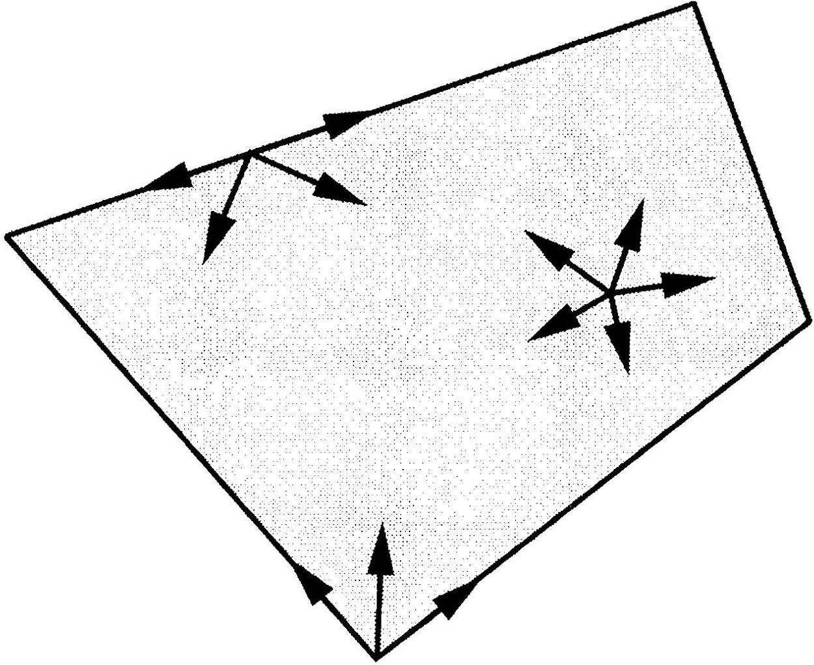
Optimality conditions
▶ Suppose that we are at a point x ∈ P and that we contemplate moving away from x, in the direction of a vector d ∈ R^{n}.
▶ Clearly, we should only consider those choices of d that do not immediately take us outside the feasible set.
▶ This leads to the following definition.
Definition 1
Let x be a point in a polyhedron P. A vector d ∈ R^{n} is said to be a feasible direction at x, if there exists a positive scalar θ for which
x + θd ∈ P.

Slide 5
Optimality conditions
▶ Let x be a basic feasible solution to the standard form problem.
▶ Let B(1), . . . , B(m) be the indices of the basic variables, and let
B = [A_{B(1)} · · · A_{B(m)}]
be the corresponding basis matrix.
▶ In particular, we have x_{i} = 0 for every nonbasic variable, while the vector x_{B} = (x_{B(1)}, . . . , x_{B(m)}) of basic variables is given by
x_{B} = B⁻¹b.

Slide 6
Optimality conditions
▶ We consider the possibility of moving away from x, to a new vector
x + θd.
▶ We do so by selecting a nonbasic variable x_{j} (which is initially at zero level), and increasing it to a positive value θ, while keeping the remaining nonbasic variables at zero.
▶ Algebraically, d_{j} = 1, and d_{i} = 0 for every nonbasic index i
other than j.
▶ At the same time, the vector x_{B} of basic variables changes to
x_{B} + θd_{B},
where d_{B} = (d_{B(1)}, d_{B(2)}, . . . , d_{B(m)}) is the vector with those components of d that correspond to the basic variables.

Slide 7
Optimality conditions
▶ Given that we are only interested in feasible solutions, we require
A(x + θd) = b ⇔ Ax + θAd = b ⇔ θAd = 0, where we have used Ax = b, since x is feasible.
▶ Thus, for the equality constraints to be satisfied for θ > 0, we need
Ad = 0.

Slide 8
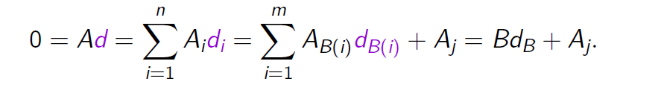
Optimality conditions
▶ Given that we are only interested in feasible solutions, we require
A(x + θd) = b ⇔ Ax + θAd = b ⇔ θAd = 0, where we have used Ax = b, since x is feasible.
▶ Thus, for the equality constraints to be satisfied for θ > 0, we need
Ad = 0.
▶ Recall now that d_{j} = 1, and that d_{i} = 0 for all other nonbasic indices i.
▶ Then,
▶ Since the basis matrix B is invertible, we obtain
d_{B} = −B⁻¹A_{j}.

Slide 9
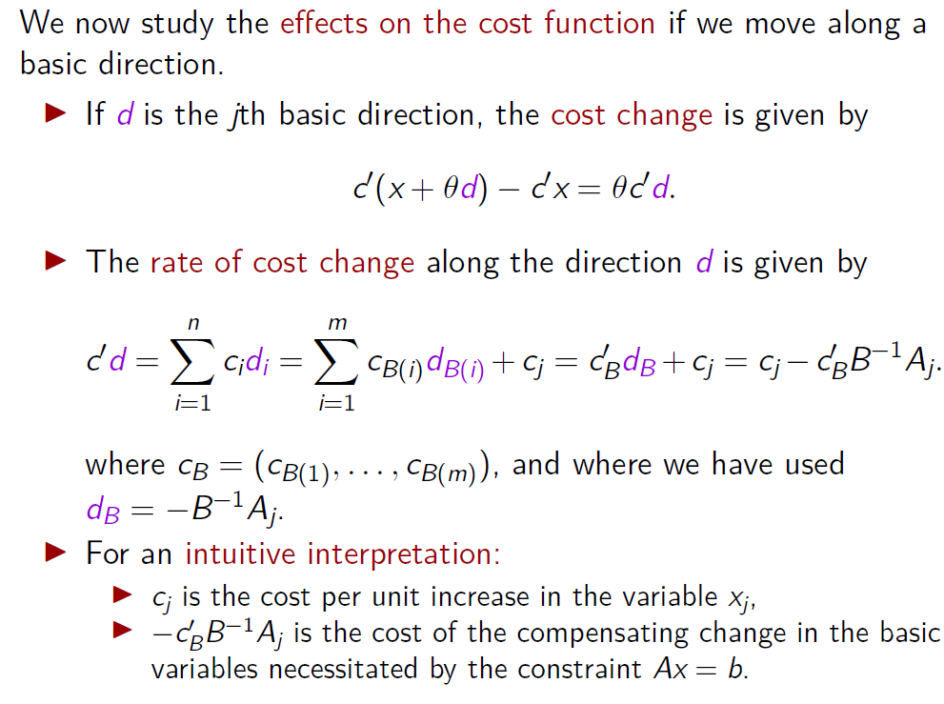
Optimality conditions

Slide 10
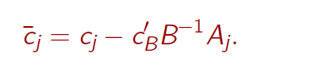
Optimality conditions
▶ The latter quantity is important enough to warrant a definition.
Definition
Let x be a basic solution, let B be an associated basis matrix, and let c_{B} be the vector of costs of the basic variables. For each j, we define the reduced cost ¯c_{j} of the variable x_{j} according to the formula
▶ Note that the definition holds also if j is a basic index!

Slide 11
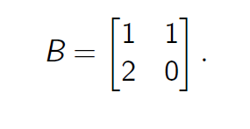
Example 1
Consider the LP problem
minimize c₁x₁ + c₂x₂ + c₃x₃ + c₄x₄
subject to x₁ + x₂ + x₃ + x₄ = 2
2x₁ + 3x₃ + 4x₄ = 2
x₁, x₂, x₃, x₄ ≥ 0.
▶ We have A₁ = (1, 2) and A₂ = (1, 0).
▶ Since they are linearly independent, we can choose x₁ and
x₂ as our basic variables.
▶ The corresponding basis matrix is

Slide 12
Example 1
Consider the LP problem
minimize c₁x₁ + c₂x₂ + c₃x₃ + c₄x₄
subject to x₁ + x₂ + x₃ + x₄ = 2
2x₁ + 3x₃ + 4x₄ = 2
x₁, x₂, x₃, x₄ ≥ 0.
▶ We set x₃ = x₄ = 0, and solve for x₁, x₂, to obtain x₁ = 1 and x₂ = 1.
▶ We have thus obtained the nondegenerate basic feasible solution
(1, 1, 0, 0).

Slide 13
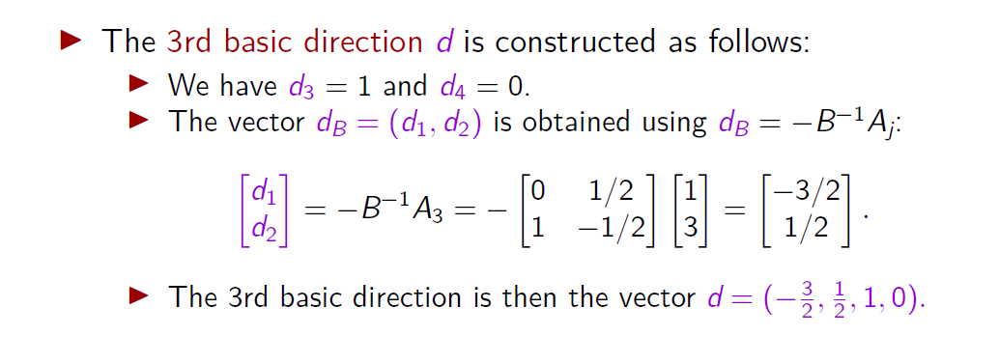
Example 1
Consider the LP problem
minimize c₁x₁ + c₂x₂ + c₃x₃ + c₄x₄
subject to x₁ + x₂ + x₃ + x₄ = 2
2x₁ + 3x₃ + 4x₄ = 2
x₁, x₂, x₃, x₄ ≥ 0.

Slide 14
Example 1
Consider the LP problem
minimize c₁x₁ + c₂x₂ + c₃x₃ + c₄x₄
subject to x₁ + x₂ + x₃ + x₄ = 2
2x₁ + 3x₃ + 4x₄ = 2
x₁, x₂, x₃, x₄ ≥ 0.
▶ The rate of cost change along this basic direction is
c′d = − ³ c₁ + ¹ c₂ + c₃.
2 2
▶ This is the same as the reduced cost of the variable x₃.

Slide 15
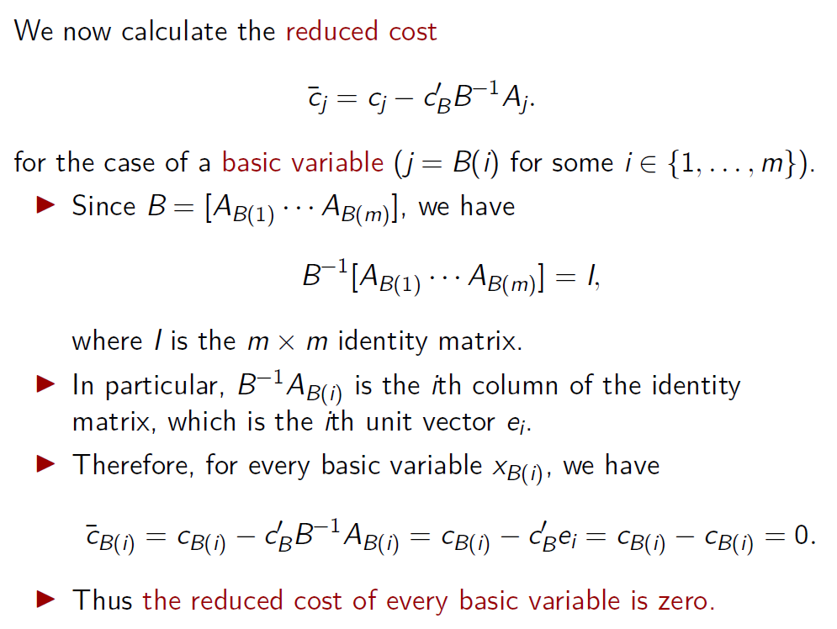
Optimality conditions

Slide 16
Optimality conditions
▶ Our next result provides us with optimality conditions.
▶ Given our interpretation of the reduced costs as rates of cost change along certain directions, this result is intuitive.
Theorem 3.1
Consider a basic feasible solution x associated with a basis matrix B, and let ¯c be the corresponding vector of reduced costs.
If ¯c ≥ 0, then x is optimal.
If x is optimal and nondegenerate, then ¯c ≥ 0.
Note that the contrapositive of (b) is:
(b’) If ¯c_{j} < 0 for some j, then x is degenerate or not optimal.

Slide 17
Optimality conditions
Theorem 3.1
Consider a basic feasible solution x associated with a basis matrix B, and let ¯c be the corresponding vector of reduced costs.
If ¯c ≥ 0, then x is optimal.
If x is optimal and nondegenerate, then ¯c ≥ 0.
▶ Note that Theorem 1 allows the possibility that x is a (degenerate) optimal basic feasible solution, but that ¯c_{j} < 0 for some nonbasic index j.
▶ According to Theorem 1, in order to decide whether a nondegenerate basic feasible solution is optimal, we need only to check whether all reduced costs are nonnegative, which is the same as examining the n − m basic directions.

Slide 18
Optimality conditions
Theorem 3.1
Consider a basic feasible solution x associated with a basis matrix B, and let ¯c be the corresponding vector of reduced costs.
If ¯c ≥ 0, then x is optimal.
If x is optimal and nondegenerate, then ¯c ≥ 0.
▶ If x is a degenerate basic feasible solution, an equally simple computational test for determining whether x is optimal is not available.
▶ Fortunately, the simplex method manages to get around this diﬀiculty.

Slide 19
Optimality conditions
▶ In order to use Theorem 1 and assert that a certain basic solution is optimal, we need to satisfy two conditions:
Feasibility,
Nonnegativity of the reduced costs.
▶ This leads us to the following definition.
Definition 3.3
A basis matrix B is said to be optimal if:
(a) B⁻¹b ≥ 0, and
(b) ¯
′ ′ ′ −1 ′
c = c − c B A ≥ 0 .
B

Slide 20
Optimality conditions
▶ If an optimal basis is found, the corresponding basic solution is feasible, satisfies the optimality conditions, and is therefore optimal.
▶ On the other hand, it can happen that we have found a basis that is not optimal, and the corresponding basic solution is optimal.
▶ In this case at least one reduced cost is negative.
▶ Thus the basic solution is degenerate.
Definition 3.3
A basis matrix B is said to be optimal if:
(a) B⁻¹b ≥ 0, and
(b) ¯
′ ′ ′ −1 ′
c = c − c B A ≥ 0 .
B

Slide 21
Development of the simplex method

Slide 22
Development of the simplex method
We now continue with the development of the simplex method.
▶ Our main task is to work out the details of how to move to a better basic feasible solution, whenever a profitable basic direction is discovered.
▶ Let us assume that every basic feasible solution is nondegenerate.
▶ This assumption will remain in effect until it is explicitly relaxed later in this section.

Slide 23
Development of the simplex method
▶ Suppose that we are at a basic feasible solution x and that we have computed the reduced costs ¯c_{j} of the nonbasic variables.
▶ If all of them are nonnegative, Theorem 1 shows that we have an optimal solution, and we stop.
▶ Otherwise, the reduced cost ¯c_{j} of a nonbasic variable x_{j} is negative, and the jth basic direction d is a feasible direction of cost decrease.
▶ While moving along this direction d, the nonbasic variable x_{j} becomes positive and all other nonbasic variables remain at zero.
▶ We describe this situation by saying that A_{j} (or x_{j}) enters the basis.

Slide 24
Development of the simplex method
▶ Once we start moving away from x along the direction d, we are tracing points of the form
x + θd, where θ ≥ 0.
▶ Since costs decrease along the direction d, it is desirable to move as far as possible.
▶ This takes us to the point x + θ∗d, where
θ∗ = max{θ ≥ 0 | x + θd ∈ P}.
▶ The resulting cost change is
θ∗c′d = θ∗¯c_{j}.

Slide 25
Development of the simplex method
We now derive a formula for θ∗.
▶ Given that Ad = 0, we have
A(x + θd) = Ax = b
∀θ ∈ R,
and the equality constraints will never be violated.
▶ Thus, x + θd can become infeasible only if one of its components becomes negative.

Slide 26
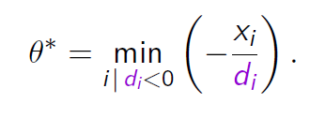
Development of the simplex method
We distinguish two cases:
If d ≥ 0, then x + θd ≥ 0 for all θ ≥ 0, the vector x + θd never becomes infeasible, and we let θ∗ = ∞.
If d_{i} < 0 for some i, the constraint x_{i} + θd_{i} ≥ 0 becomes
x_{i}
θ ≤ − _{di} .
▶ This constraint on θ must be satisfied for every i with d_{i} < 0.
▶ Thus, the largest possible value of θ is

Slide 27
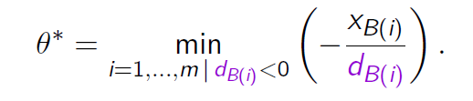
Development of the simplex method
▶ Recall that if x_{i} is a nonbasic variable, then either x_{i} is the entering variable and d_{i} = 1, or else d_{i} = 0.
▶ In either case, d_{i} is nonnegative.
▶ Thus, we only need to consider the basic variables and we have the equivalent formula
▶ Note that θ∗ > 0, because x_{B(i)} > 0 for all i, as a consequence of nondegeneracy.

Slide 28
Example 2
This is a continuation of Example 1.
minimize c₁x₁ + c₂x₂ + c₃x₃ + c₄x₄
subject to x₁ + x₂ + x₃ + x₄ = 2
2x₁ + 3x₃ + 4x₄ = 2
x₁, x₂, x₃, x₄ ≥ 0.
▶ We again consider the basic feasible solution
x = (1, 1, 0, 0).
▶ The reduced cost ¯c₃ of the nonbasic variable x₃ was
3 1
¯c₃ = − ₂ c₁ + ₂ c₂ + c₃.
▶ Suppose that c = (2, 0, 0, 0), in which case, we have ¯c₃ = −3.

Slide 29
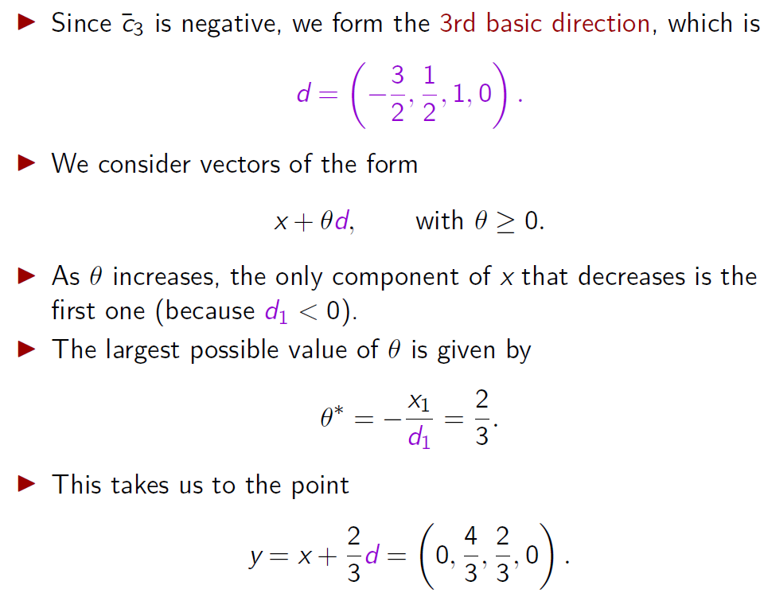
Example 2

Slide 30

Example 3.2
minimize c₁x₁ + c₂x₂ + c₃x₃ + c₄x₄
subject to x₁ + x₂ + x₃ + x₄ = 2
2x₁ + 3x₃ + 4x₄ = 2
x₁, x₂, x₃, x₄ ≥ 0.
▶ Consider our new vector y
▶ The columns corresponding to the nonzero variables at the new vector y are A₂ = (1, 0) and A₃ = (1, 3), and are linearly independent.
▶ Therefore, they form a basis and the vector y is the corresponding basic feasible solution.
▶ In particular, A₃ (or x₃) has entered the basis and A₁ (or x₁) has exited the basis.

Slide 31
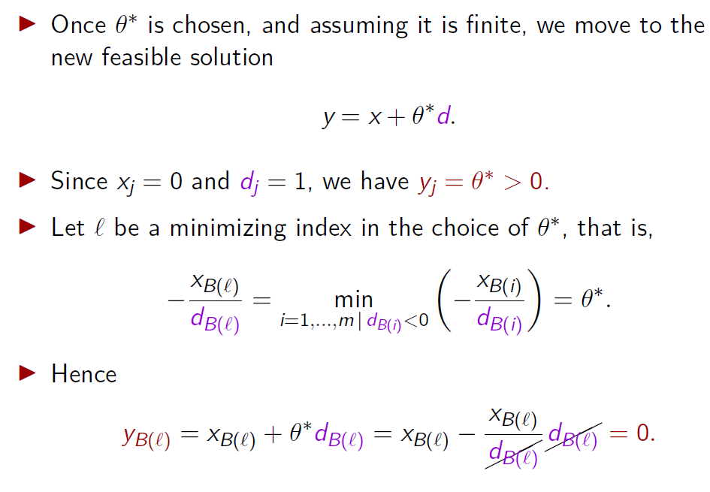
Development of the simplex method

Slide 32
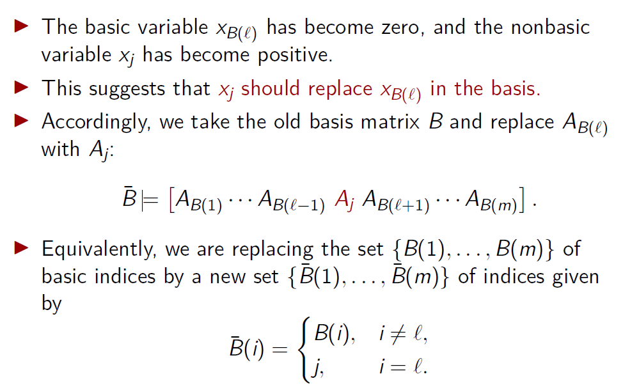
Development of the simplex method

Slide 33
Development of the simplex method
Theorem 2
The columns A_{B}¯_{(i)}, i = 1, . . . , m, are linearly independent and, therefore, B¯ is a basis matrix.
The vector y = x + θ∗d is a basic feasible solution associated with the basis matrix B¯.

Slide 34
Development of the simplex method
▶ Since θ∗ > 0, the new basic feasible solution x + θ∗d is distinct from x.
▶ Since d is a direction of cost decrease, the cost of this new basic feasible solution is strictly smaller than the cost of x.
▶ We have therefore accomplished our objective of moving to a new basic feasible solution with lower cost.

Slide 35
Development of the simplex method
▶ We can now summarize a typical iteration of the simplex method, also known as a pivot.
▶ It is convenient to define a vector u = (u₁, . . . , u_{m}) by letting
u = −d_{B} = B⁻¹A_{j},
where A_{j} is the column that enters the basis.
▶ In particular,
u_{i} = −d_{B(i)}, for i = 1, . . . , m.

Slide 36
Development of the simplex method
An iteration of the simplex method
1. We start with a basis consisting of the basic columns A_{B(1)}, . . . , A_{B(m)}, and an associated basic feasible solution x.
′ −1
2. Compute the reduced costs ¯c = c − c B A for all
j j
B
j
nonbasic indices j.
▶ If they are all nonnegative, the current basic feasible solution is optimal, and the algorithm terminates.
▶ Else, choose some j for which ¯c_{j} < 0.
3. Compute u = B⁻¹A_{j}. If no component of u is positive, we have θ∗ = ∞, the optimal cost is −∞, and the algorithm terminates.

Slide 37
Development of the simplex method
An iteration of the simplex method
4. If some component of u is positive, let
∗
^{x}B(i)
θ =
min
.
i=1,...,m | u >0 u_{i}
i
5. Let ℓ be such that
^{x}B(ℓ) u
θ∗ =
.
ℓ
Form a new basis by replacing A_{B(ℓ)} with A_{j}. If y is the new basic feasible solution, the values of the new basic variables are y_{j} = θ∗ and y_{B(i)} = x_{B(i)} − θ∗u_{i}, i ̸= ℓ.

Slide 38
Development of the simplex method
▶ The simplex method is initialized with an arbitrary basic feasible solution, which, for feasible standard form problems, is guaranteed to exist.

Slide 39
Development of the simplex method
▶ The following theorem states that, in the nondegenerate case, the simplex method works correctly and terminates after a finite number of iterations.
Theorem 3
Assume that the feasible set is nonempty and that every basic feasible solution is nondegenerate. Then, the simplex method terminates after a finite number of iterations. At termination, there are the following two possibilities:
We have an optimal basis B and an associated basic feasible solution which is optimal.
We have found a vector d satisfying Ad = 0, d ≥ 0, and
c′d < 0, and the optimal cost is −∞.

Slide 40
Development of the simplex method
▶ In particular, it shows that for standard form problems that are nondegenerate and feasible:
▶ either the optimal cost is −∞, or
▶ there exists a basic feasible solution which is optimal.

Slide 41
The simplex method for degenerate problems

Slide 42
The simplex method for degenerate problems
▶ We have been working so far under the assumption that all basic feasible solutions are nondegenerate.
▶ Suppose now that the same algorithm is used in the presence of degeneracy.
▶ Then, the following new possibilities may be encountered in the course of the algorithm.

Slide 43
The simplex method for degenerate problems
(a) If the current basic feasible solution x is degenerate, θ∗ can be equal to zero, in which case, the new basic feasible solution y is the same as x.
▶ This happens if some basic variable x_{B(ℓ)} is equal to zero and the corresponding component d_{B(ℓ)} of the direction vector d is negative.
▶ Nevertheless, we can still define a new basis B¯, by replacing
A_{B(ℓ)} with A_{j}, and Theorem 2 is still valid.
Theorem 2
The columns A_{B(i)}, i ̸= ℓ, and A_{j} are linearly independent and, therefore, B¯ is a basis matrix.
The vector y = x + θ∗d is a basic feasible solution associated with the basis matrix B¯.

Slide 44
The simplex method for degenerate problems
(b) Even if θ∗ is positive, it may happen that more than one of the original basic variables becomes zero at the new point x + θ∗d.
▶ Since only one of them exits the basis, the others remain in the basis at zero level, and the new basic feasible solution is degenerate.

Slide 45
The simplex method for degenerate problems
▶ Basis changes while staying at the same basic feasible solution are not in vain.
▶ A sequence of such basis changes may lead to the eventual discovery of a cost reducing feasible direction.

Slide 46
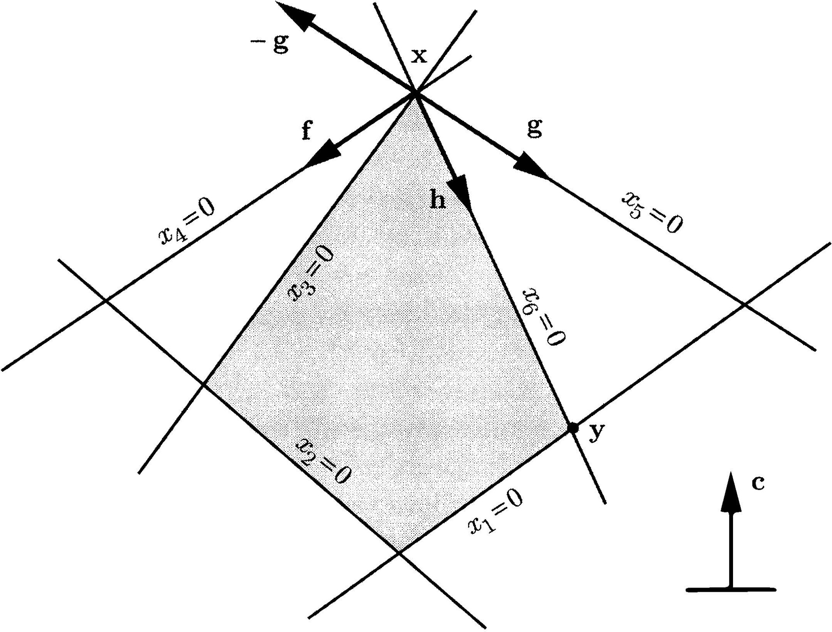
The simplex method for degenerate problems
Example:
▶ The basic feasible solution x is degenerate.
▶ If x₄ and x₅ are the nonbasic variables, then
▶ the 4th basic direction is g,
▶ the 5th basic direction is f.
▶ For either of these two basic directions, we have θ∗ = 0.

Slide 47
The simplex method for degenerate problems
Example:
▶ However, if we perform a change of basis, with x₄ entering the basis and x₆ exiting, the new nonbasic variables are x₅ and x₆.
▶ Then
▶ the 5th basic direction is h,
▶ the 6th basic direction is −g.
▶ In particular, we can now follow direction h to reach a new basic feasible solution y with lower cost.

Slide 48
The simplex method for degenerate problems
▶ A sequence of basis changes might lead back to the initial basis, in which case the algorithm may loop indefinitely.
▶ This undesirable phenomenon is called cycling.
▶ It is sometimes maintained that cycling is an exceptionally rare phenomenon.
▶ However, for many highly structured LP problems, most basic feasible solutions are degenerate, and cycling is a real possibility.
▶ We will see that cycling can be avoided by judiciously choosing the variables that will enter or exit the basis.
▶ We now discuss the freedom available in this respect.

Slide 49
Pivot Selection

Slide 50
Pivot Selection
▶ The simplex algorithm, as we described it, has certain degrees of freedom:
▶ In Step 2, we are free to choose any j whose reduced cost ¯c_{j} is negative.
▶ In Step 5, there may be several indices ℓ that attain the minimum in the definition of θ∗, and we are free to choose any one of them.
▶ Rules for making such choices are called pivoting rules.

Slide 51
Pivot Selection
Regarding the choice of the entering column, the following rules are some natural candidates:
(a) Choose a column A_{j}, with ¯c_{j} < 0, whose reduced cost is the most negative.
▶ Since the reduced cost is the rate of change of the cost function, this rule chooses a direction along which the cost decreases at the fastest rate.

Slide 52
Pivot Selection
Regarding the choice of the entering column, the following rules are some natural candidates:
(a) Choose a column A_{j}, with ¯c_{j} < 0, whose reduced cost is the most negative.
▶ Since the reduced cost is the rate of change of the cost function, this rule chooses a direction along which the cost decreases at the fastest rate.
▶ However, the actual cost decrease depends on how far we move along the chosen direction.
▶ This suggests the next rule.

Slide 53
Pivot Selection
(b) Choose a column with ¯c_{j} < 0 for which the corresponding cost decrease θ∗ |¯c_{j}| is largest.
▶ This rule offers the possibility of reaching optimality after a smaller number of iterations.
▶ On the other hand, the computational burden at each iteration is larger, because we need to compute θ∗ for each column with ¯c_{j} < 0.
▶ The available empirical evidence suggests that the overall running time does not improve.

Slide 54
Pivot Selection
▶ For large problems, even rule (a) can be computationally expensive, because it requires the computation of the reduced cost of every variable.
▶ In practice, simpler rules are sometimes used, such as the smallest subscript rule, that chooses the smallest j for which ¯c_{j} is negative.
▶ Under this rule, once a negative reduced cost is discovered, there is no reason to compute the remaining reduced costs.

Slide 55
Pivot Selection
▶ Regarding the choice of the exiting column, the simplest option is again the smallest subscript rule: out of all variables eligible to exit the basis, choose one with the smallest subscript.
▶ It turns out that by following the smallest subscript rule for both the entering and the exiting column, cycling can be avoided (cf. Section 3.4).

Slide 56
Implementations of the simplex method
▶ It should be clear from the statement of the algorithm that the vectors B⁻¹A_{j} play a key role.
▶ If these vectors are available, then we can easily compute:
▶ The reduced costs
′ −1
¯c = c − c B A .
j j B j
▶ The direction of motion
−u = −B⁻¹A_{j}.
▶ The stepsize
x
B(i) .
θ∗ = min
i=1,...,m | ui >0
u_{i}
▶ The main difference between alternative implementations lies in:
▶ The way that the vectors B⁻¹A_{j} are computed,
▶ The amount of related information that is carried from one iteration to the next.

Slide 57
Naive implementation

Slide 58
Naive implementation
We start by describing the most straightforward implementation.
▶ At the beginning of a typical iteration, we have the indices
B(1), . . . , B(m) of the current basic variables.
▶ We form the basis matrix B and solve the linear system
′ ′
B
p B = c to compute
′ ′ −1
p = c B .
B
This vector p ∈ R^{m} is called the vector of simplex multipliers associated with the basis B.

Slide 59
Naive implementation
We start by describing the most straightforward implementation.
▶ At the beginning of a typical iteration, we have the indices
B(1), . . . , B(m) of the current basic variables.
▶ We form the basis matrix B and solve the linear system
′ ′
B
p B = c to compute
′ ′ −1
p = c B .
[O(m³) operations]
B
This vector p ∈ R^{m} is called the vector of simplex multipliers associated with the basis B.

Slide 60
Naive implementation
We start by describing the most straightforward implementation.
▶ At the beginning of a typical iteration, we have the indices
B(1), . . . , B(m) of the current basic variables.
▶ We form the basis matrix B and solve the linear system
′ ′
p B = c to compute
B
′ ′ −1
p = c B .
B
This vector p ∈ R^{m} is called the vector of simplex multipliers associated with the basis B.
▶
′ −1
The reduced cost ¯c = c − c B A of any variable x is then
j j
B
j j
obtained according to the formula
¯c_{j} = c_{j} − p′A_{j}.
▶ Regardless of the pivoting rule employed, we may have to compute all of the reduced costs.

Slide 61
Naive implementation
We start by describing the most straightforward implementation.
▶ At the beginning of a typical iteration, we have the indices
B(1), . . . , B(m) of the current basic variables.
▶ We form the basis matrix B and solve the linear system
′ ′
p B = c to compute
B
′ ′ −1
p = c B .
B
This vector p ∈ R^{m} is called the vector of simplex multipliers associated with the basis B.
▶
′ −1
The reduced cost ¯c = c − c B A of any variable x is then
j j
B
j j
obtained according to the formula
¯c_{j} = c_{j} − p′A_{j}.
▶ Regardless of the pivoting rule employed, we may have to compute all of the reduced costs.

Slide 62
Naive implementation
▶ Once a column A_{j} is selected to enter the basis, we solve the linear system Bu = A_{j} in order to determine the vector
u = B⁻¹A_{j}.
▶ At this point, we can form the direction along which we will be moving away from the current basic feasible solution.
▶ We finally determine
^{x}B(i)
i=1,...,m | u >0 u_{i}
∗
θ = min
i
and the variable that will exit the basis, and construct the new basic feasible solution.

Slide 63
Naive implementation
▶ Once a column A_{j} is selected to enter the basis, we solve the linear system Bu = A_{j} in order to determine the vector
u = B⁻¹A_{j}.
▶ At this point, we can form the direction along which we will be moving away from the current basic feasible solution.
▶ We finally determine
^{x}B(i)
i=1,...,m | u >0 u_{i}
∗
θ = min
i
and the variable that will exit the basis, and construct the new basic feasible solution.

Slide 64
Revised simplex method

Slide 65
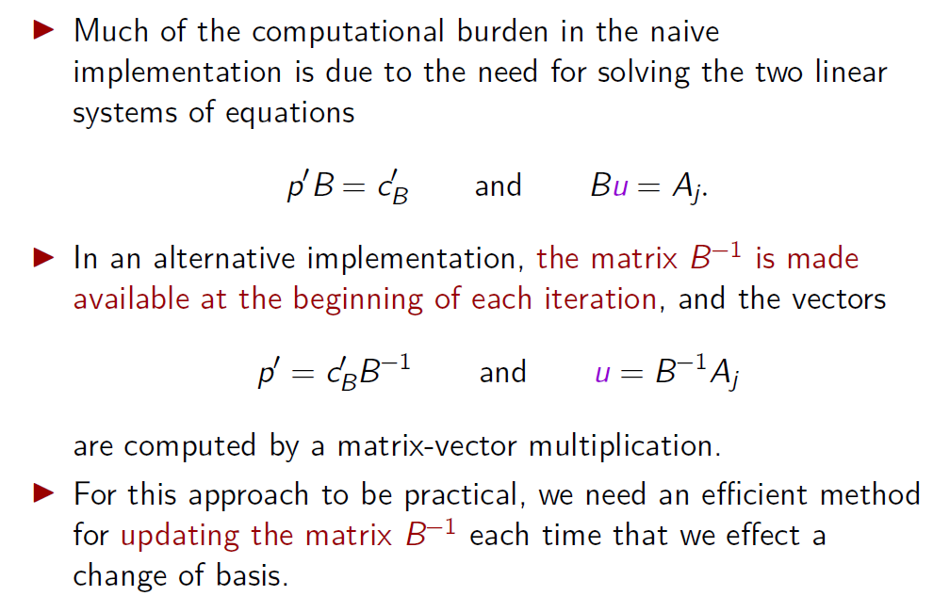
Revised simplex method

Slide 66
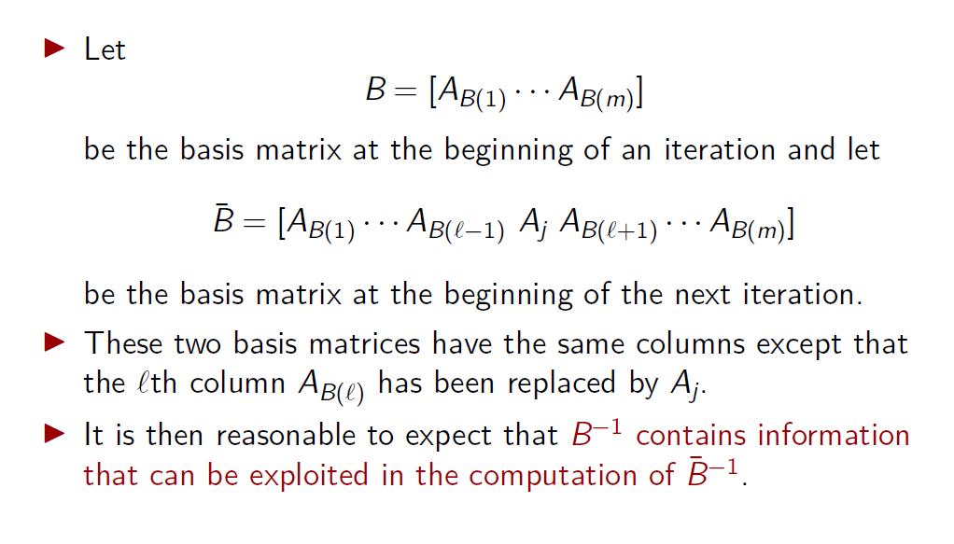
Revised simplex method

Slide 67
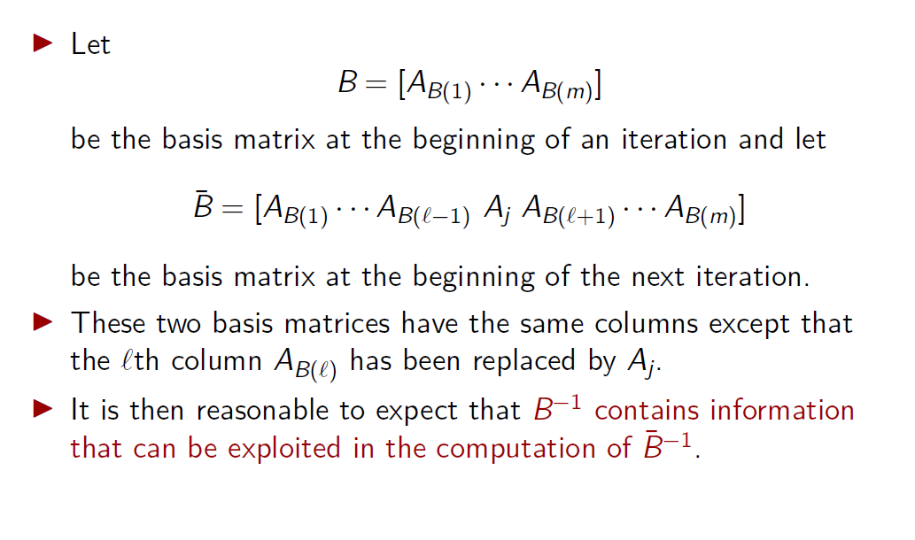
Revised simplex method

Slide 68
Revised simplex method
Definition 3.4
Given a matrix, the operation of adding a constant multiple of one row to the same or to another row is called an elementary row operation.
▶ Performing an elementary row operation on a matrix C is equivalent to forming the matrix QC, where Q is a suitably constructed square matrix.

Slide 69
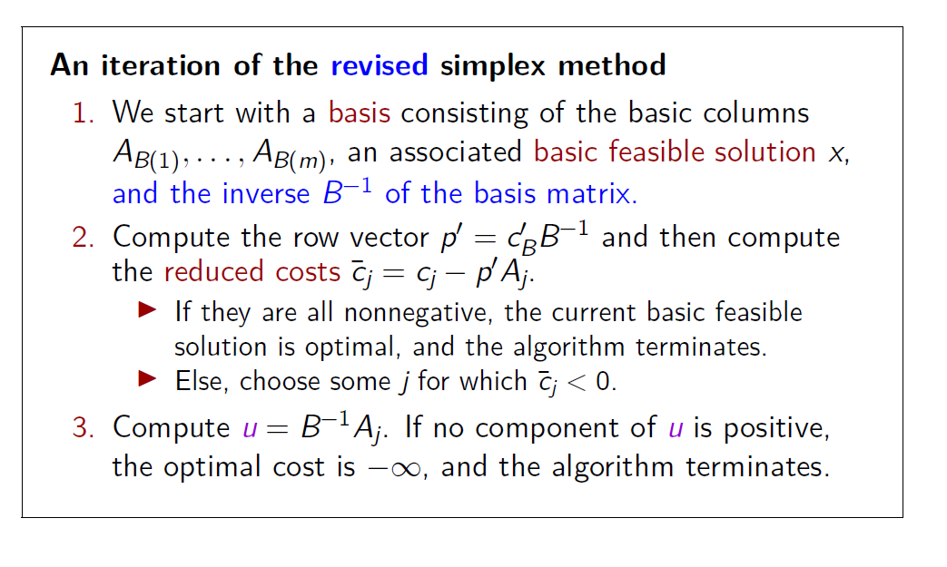
Revised simplex method

Slide 70
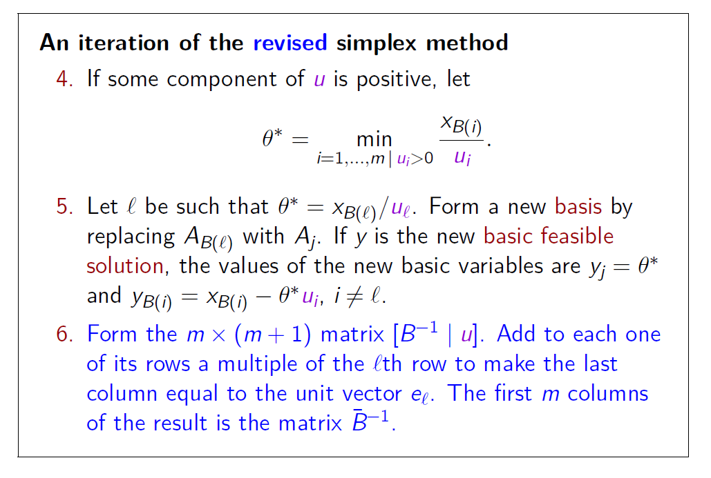
Revised simplex method

Slide 71
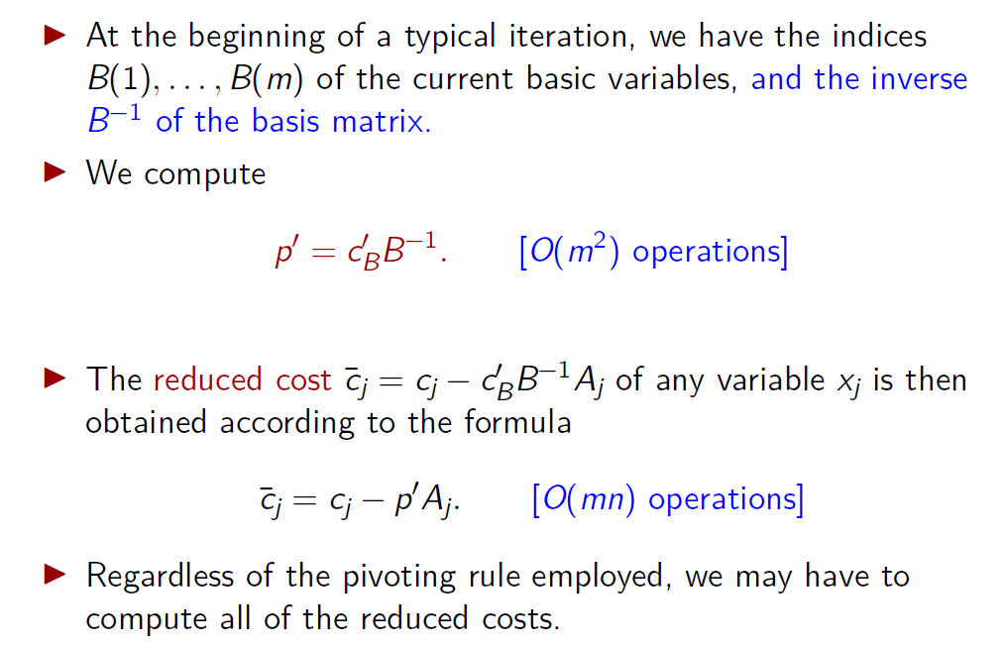
Revised simplex method: implementation

Slide 72
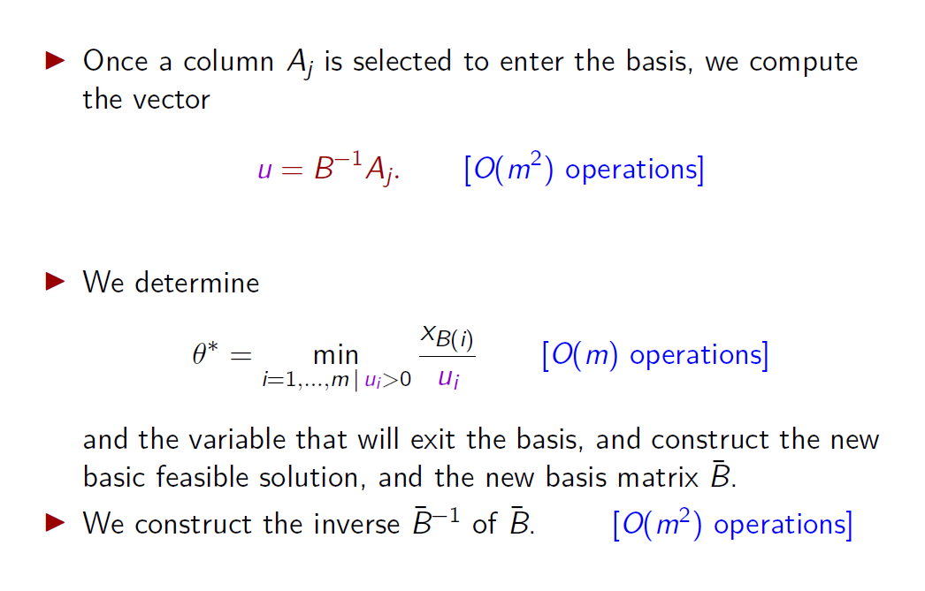
Revised simplex method: implementation

Slide 73
The full tableau implementation

Slide 74
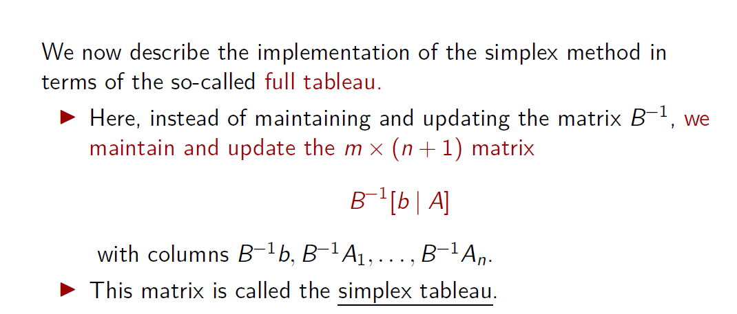
The full tableau implementation

Slide 75
The full tableau implementation
▶ The column B⁻¹b is called the zeroth column and contains the values of the basic variables.
▶ The column B⁻¹A_{i} is called the ith column of the tableau.
▶ The column u = B⁻¹A_{j} corresponding to the variable that enters the basis is called the pivot column.
^{x}B(1) . | (B⁻¹A₁)₁ . . . . | u₁ . | . . . (B⁻¹A_{n})₁ .
^{x}B(ℓ) | (B⁻¹A₁)_{ℓ} . . . | u_{ℓ} | . . . (B⁻¹A_{n})_{ℓ}
. ^{x}B(m) | . (B⁻¹A₁)_{m} . . . | . u_{m} | . . . . (B⁻¹A_{n})_{m}

Slide 76
The full tableau implementation
▶ If the ℓth basic variable exits the basis, the ℓth row of the tableau is called the pivot row.
▶ The element belonging to both the pivot row and the pivot column is called the pivot element.
▶ Note that the pivot element is u_{ℓ} and is always positive (unless u ≤ 0, in which case the algorithm has met the termination condition in Step 3).
^{x}B(1) . | (B⁻¹A₁)₁ . . . . | u₁ . | . . . (B⁻¹A_{n})₁ .
^{x}B(ℓ) | (B⁻¹A₁)_{ℓ} . . . | u_{ℓ} | . . . (B⁻¹A_{n})_{ℓ}
. ^{x}B(m) | . (B⁻¹A₁)_{m} . . . | . u_{m} | . . . . (B⁻¹A_{n})_{m}

Slide 77
The full tableau implementation
The information contained in the rows of the tableau
B⁻¹[b | A]
admits the following interpretation.
▶ The equality constraints are initially given to us in the form
b = Ax.
▶ Given the current basis matrix B, these equality constraints can also be expressed in the equivalent form
B⁻¹b = B⁻¹Ax.
▶ The tableau provides us with the coeﬀicients of these equality constraints.

Slide 78
The full tableau implementation
▶ At the end of each iteration, we need to update the tableau
B⁻¹[b | A] and compute
B^{¯−1}[b | A].
▶ This can be accomplished by left-multiplying the simplex tableau with a matrix Q satisfying QB⁻¹ = B^{¯−1}.
▶ As explained earlier, this is the same as performing those elementary row operations that turn B⁻¹ to B^{¯−1}.
▶ That is, we add to each row a multiple of the pivot row to set all entries of the pivot column to zero, with the exception of the pivot element which is set to one.

Slide 79
The full tableau implementation
Regarding the determination of the exiting column A_{B(ℓ)} and the stepsize θ∗, Steps 4 and 5 of the simplex method amount to:
▶ ^{xB(i)} is the ratio of the ith entry in the zeroth column of the
ui
tableau to the ith entry in the of the tableau.
pivot column
▶ We only consider those i for which u_{i} is positive.
▶ The smallest ratio is equal to θ∗ and determines ℓ.
^{x}B(1) . | (B⁻¹A₁)₁ . . . . | u₁ . | . . . (B⁻¹A_{n})₁ .
^{x}B(ℓ) | (B⁻¹A₁)_{ℓ} . . . | u_{ℓ} | . . . (B⁻¹A_{n})_{ℓ}
. ^{x}B(m) | . (B⁻¹A₁)_{m} . . . | . u_{m} | . . . . (B⁻¹A_{n})_{m}

Slide 80
The zeroth row
It is customary to augment the simplex tableau by including a top row, to be referred to as the zeroth row.
^{x}B(1) . | (B⁻¹A₁)₁ . . . . | u₁ . | . . . (B⁻¹A_{n})₁ .
^{x}B(ℓ) | (B⁻¹A₁)_{ℓ} . . . | u_{ℓ} | . . . (B⁻¹A_{n})_{ℓ}
. ^{x}B(m) | . (B⁻¹A₁)_{m} . . . | . u_{m} | . . . . (B⁻¹A_{n})_{m}

Slide 81
The zeroth row
It is customary to augment the simplex tableau by including a top row, to be referred to as the zeroth row.
▶ The entry at the top left corner contains the negative of the current cost:
′ ′ −1
−c x = −c B b
.
B B B
▶ The reason for the minus sign is that it allows for a simple update rule.
− c′ x_{B} B
^{x}B(1) . | (B⁻¹A₁)₁ . . . . | u₁ . | . . . (B⁻¹A_{n})₁ .
^{x}B(ℓ) | (B⁻¹A₁)_{ℓ} . . . | u_{ℓ} | . . . (B⁻¹A_{n})_{ℓ}
. ^{x}B(m) | . (B⁻¹A₁)_{m} . . . | . u_{m} | . . . . (B⁻¹A_{n})_{m}

Slide 82
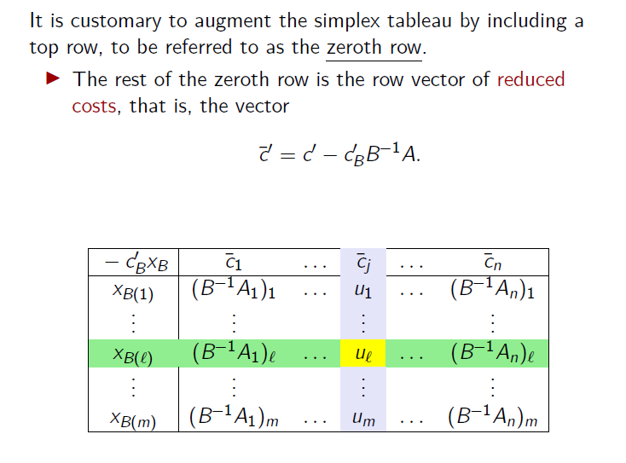
The zeroth row

Slide 83
The zeroth row
▶ The rule for updating the zeroth row turns out to be identical to the rule used for the other rows of the tableau:
Add a multiple of the pivot row to the zeroth row to set the reduced cost of the entering variable to zero.
▶ We will now verify that this update rule produces the correct results for the zeroth row.

Slide 84
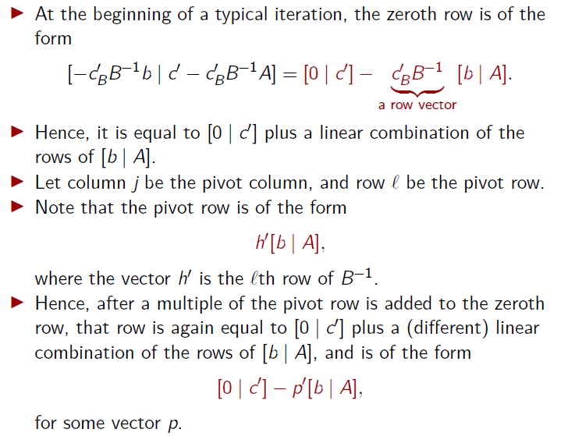

Slide 85
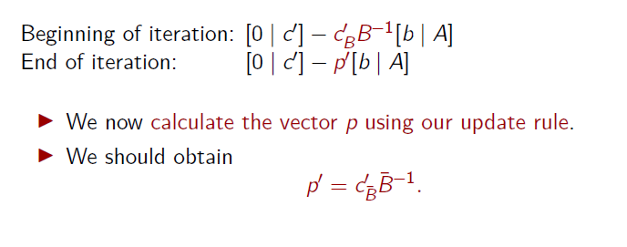
The zeroth row

Slide 86
The zeroth row
a) Consider the column B¯(ℓ) of the tableau.
−c′ x_{B} B | ¯c₁ . . . | ¯c_{j} | . . . ¯c_{n}
^{x}B(1) . | (B⁻¹A₁)₁ . . . . | u₁ . | . . . (B⁻¹A_{n})₁ .
^{x}B(ℓ) | (B⁻¹A₁)_{ℓ} . . . | u_{ℓ} | . . . (B⁻¹A_{n})_{ℓ}
. ^{x}B(m) | . (B⁻¹A₁)_{m} . . . | . u_{m} | . . . . (B⁻¹A_{n})_{m}
▶ Recall that B¯(ℓ) = j, thus this is the pivot column.
▶ Our update rule is such that the pivot column entry of the zeroth row becomes zero.
▶ We obtain
^{c}B¯(ℓ) ^{− p′A}B¯(ℓ) ^{= 0.}

Slide 87
The zeroth row
b) Consider the column B¯(i) of the tableau, for i ̸= ℓ.
−c′ x_{B} B | ¯c₁ | . . . | ¯c_{j} | . . . | ^{¯c}B¯(i) | . . . | ¯c_{n}
^{x}B(1) | (B⁻¹A₁)₁ | . . . | u₁ | . . . | (B⁻¹A_{B}¯_{(i)})₁ | . . . | (B⁻¹A_{n})₁
. | . |  | . |  | . |  | .
^{x}B(ℓ) | (B⁻¹A₁)_{ℓ} | . . . | u_{ℓ} | . . . | (B⁻¹A_{B}¯_{(i)})_{ℓ} | . . . | (B⁻¹A_{n})_{ℓ}
. ^{x}B(i) | . (B⁻¹A₁)_{i} | . . . | . u_{i} | . . . | . (B⁻¹A_{B}¯_{(i)})_{i} | . . . | . (B⁻¹A_{n})_{i}
. ^{x}B(m) | . (B⁻¹A₁)_{m} | . . . | . u_{m} | . . . | . (B⁻¹A_{B}¯_{(i)})_{m} | . . . | . (B⁻¹A_{n})_{m}
▶ This is a column corresponding to a basic variable that stays in the basis. Thus B¯(i) = B(i).
▶ The zeroth row entry of that column is zero, before the change of basis, since it is the reduced cost of a basic variable.

Slide 88
The zeroth row
b) Consider the column B¯(i) of the tableau, for i ̸= ℓ.
−c′ x_{B} B | ¯c₁ | . . . | ¯c_{j} | . . . | ^{¯c}B(i) | . . . | ¯c_{n}
^{x}B(1) | (B⁻¹A₁)₁ | . . . | u₁ | . . . | ^{(B−1A}B(i)⁾1 | . . . | (B⁻¹A_{n})₁
. | . |  | . |  | . |  | .
^{x}B(ℓ) | (B⁻¹A₁)_{ℓ} | . . . | u_{ℓ} | . . . | ^{(B−1A}B(i)⁾ℓ | . . . | (B⁻¹A_{n})_{ℓ}
. ^{x}B(i) | . (B⁻¹A₁)_{i} | . . . | . u_{i} | . . . | . ^{(B−1A}B(i)⁾i | . . . | . (B⁻¹A_{n})_{i}
. ^{x}B(m) | . (B⁻¹A₁)_{m} | . . . | . u_{m} | . . . | . ^{(B−1A}B(i)⁾m | . . . | . (B⁻¹A_{n})_{m}
▶ This is a column corresponding to a basic variable that stays in the basis. Thus B¯(i) = B(i).
▶ The zeroth row entry of that column is zero, before the change of basis, since it is the reduced cost of a basic variable.

Slide 89
The zeroth row
b) Consider the column B¯(i) of the tableau, for i ̸= ℓ.
−c′ x_{B} B | ¯c₁ | . . . | ¯c_{j} | . . . | 0 | . . . | ¯c_{n}
^{x}B(1) | (B⁻¹A₁)₁ | . . . | u₁ | . . . | ^{(B−1A}B(i)⁾1 | . . . | (B⁻¹A_{n})₁
. | . |  | . |  | . |  | .
^{x}B(ℓ) | (B⁻¹A₁)_{ℓ} | . . . | u_{ℓ} | . . . | ^{(B−1A}B(i)⁾ℓ | . . . | (B⁻¹A_{n})_{ℓ}
. ^{x}B(i) | . (B⁻¹A₁)_{i} | . . . | . u_{i} | . . . | . ^{(B−1A}B(i)⁾i | . . . | . (B⁻¹A_{n})_{i}
. ^{x}B(m) | . (B⁻¹A₁)_{m} | . . . | . u_{m} | . . . | . ^{(B−1A}B(i)⁾m | . . . | . (B⁻¹A_{n})_{m}
▶ This is a column corresponding to a basic variable that stays in the basis. Thus B¯(i) = B(i).
▶ The zeroth row entry of that column is zero, before the change of basis, since it is the reduced cost of a basic variable.

Slide 90
The zeroth row
b) Consider the column B¯(i) of the tableau, for i ̸= ℓ.
−c′ x_{B} B | ¯c₁ | . . . | ¯c_{j} | . . . | 0 | . . . | ¯c_{n}
^{x}B(1) | (B⁻¹A₁)₁ | . . . | u₁ | . . . | ^{(B−1A}B(i)⁾1 | . . . | (B⁻¹A_{n})₁
. | . |  | . |  | . |  | .
^{x}B(ℓ) | (B⁻¹A₁)_{ℓ} | . . . | u_{ℓ} | . . . | ^{(B−1A}B(i)⁾ℓ | . . . | (B⁻¹A_{n})_{ℓ}
. ^{x}B(i) | . (B⁻¹A₁)_{i} | . . . | . u_{i} | . . . | . ^{(B−1A}B(i)⁾i | . . . | . (B⁻¹A_{n})_{i}
. ^{x}B(m) | . (B⁻¹A₁)_{m} | . . . | . u_{m} | . . . | . ^{(B−1A}B(i)⁾m | . . . | . (B⁻¹A_{n})_{m}
▶ Before the operation, the B(i)th column is B⁻¹A_{B(i)}, thus it
is the ith unit vector.
▶ Since i ̸= ℓ, the entry in the equal to zero.
pivot row
for that column is

Slide 91
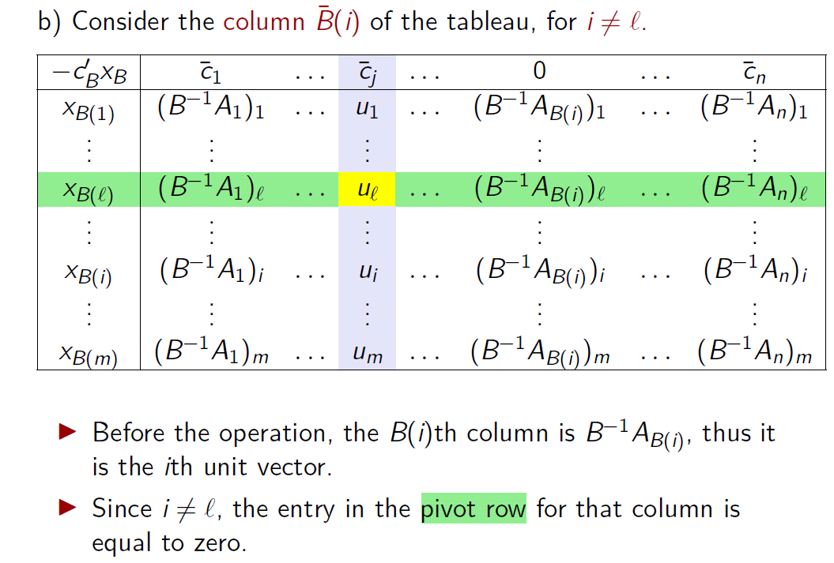
The zeroth row

Slide 92
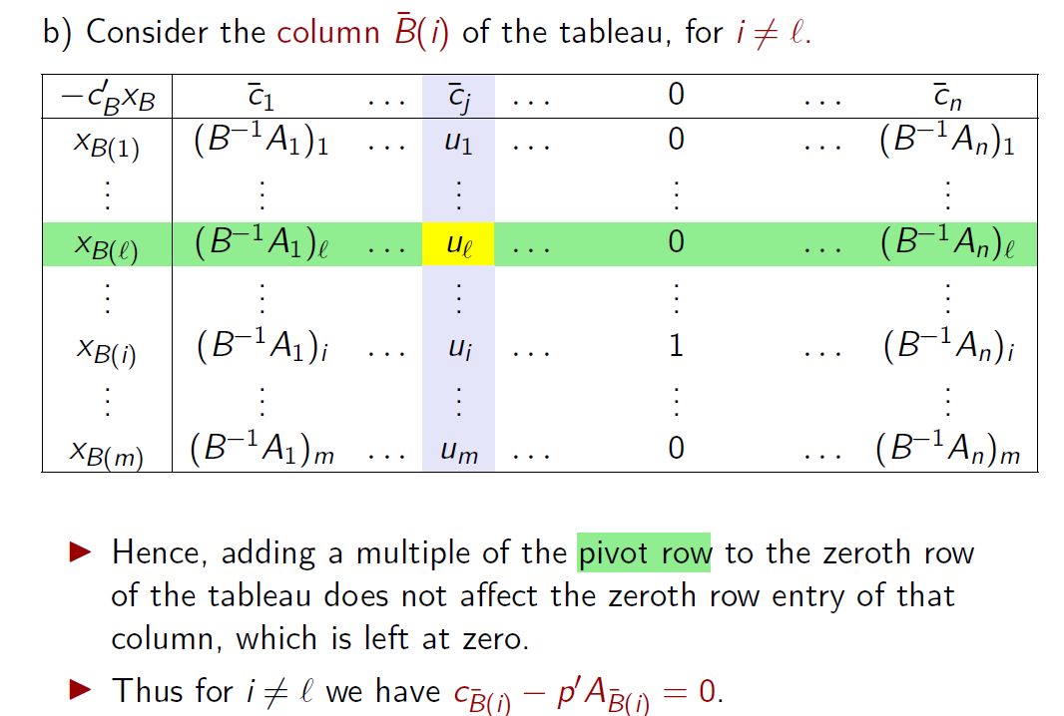
The zeroth row

Slide 93
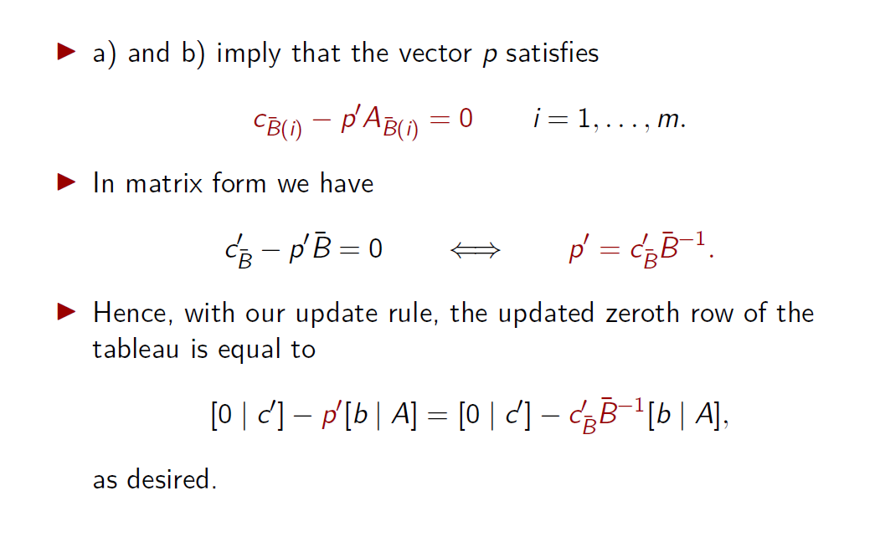
The zeroth row

Slide 94
The full tableau implementation
We can now summarize the mechanics of the full tableau implementation.
An iteration of the full tableau implementation
A typical iteration starts with the tableau associated with a basis matrix B and the corresponding basic feasible solution x.
Examine the reduced costs in the zeroth row of the tableau.
▶ If they are all nonnegative, the current basic feasible solution is optimal, and the algorithm terminates.
▶ Else, choose some j for which ¯c_{j} < 0.
Consider the vector u = B⁻¹A_{j}, which is the jth column (the pivot column) of the tableau. If no component of u is positive, the optimal cost is −∞, and the algorithm terminates.

Slide 95
The full tableau implementation
An iteration of the full tableau implementation
4. For each i for which u_{i} is positive, compute the ratio
^{x}B(i) u_{i}
.
Let ℓ be the index of a row that corresponds to the smallest ratio. The column A_{B(ℓ)} exits the basis and the column A_{j} enters the basis.
5. Add to each row of the tableau a constant multiple of the ℓth row (the pivot row) so that u_{ℓ} (the pivot element) becomes one and all other entries of the pivot column become zero.

Slide 96
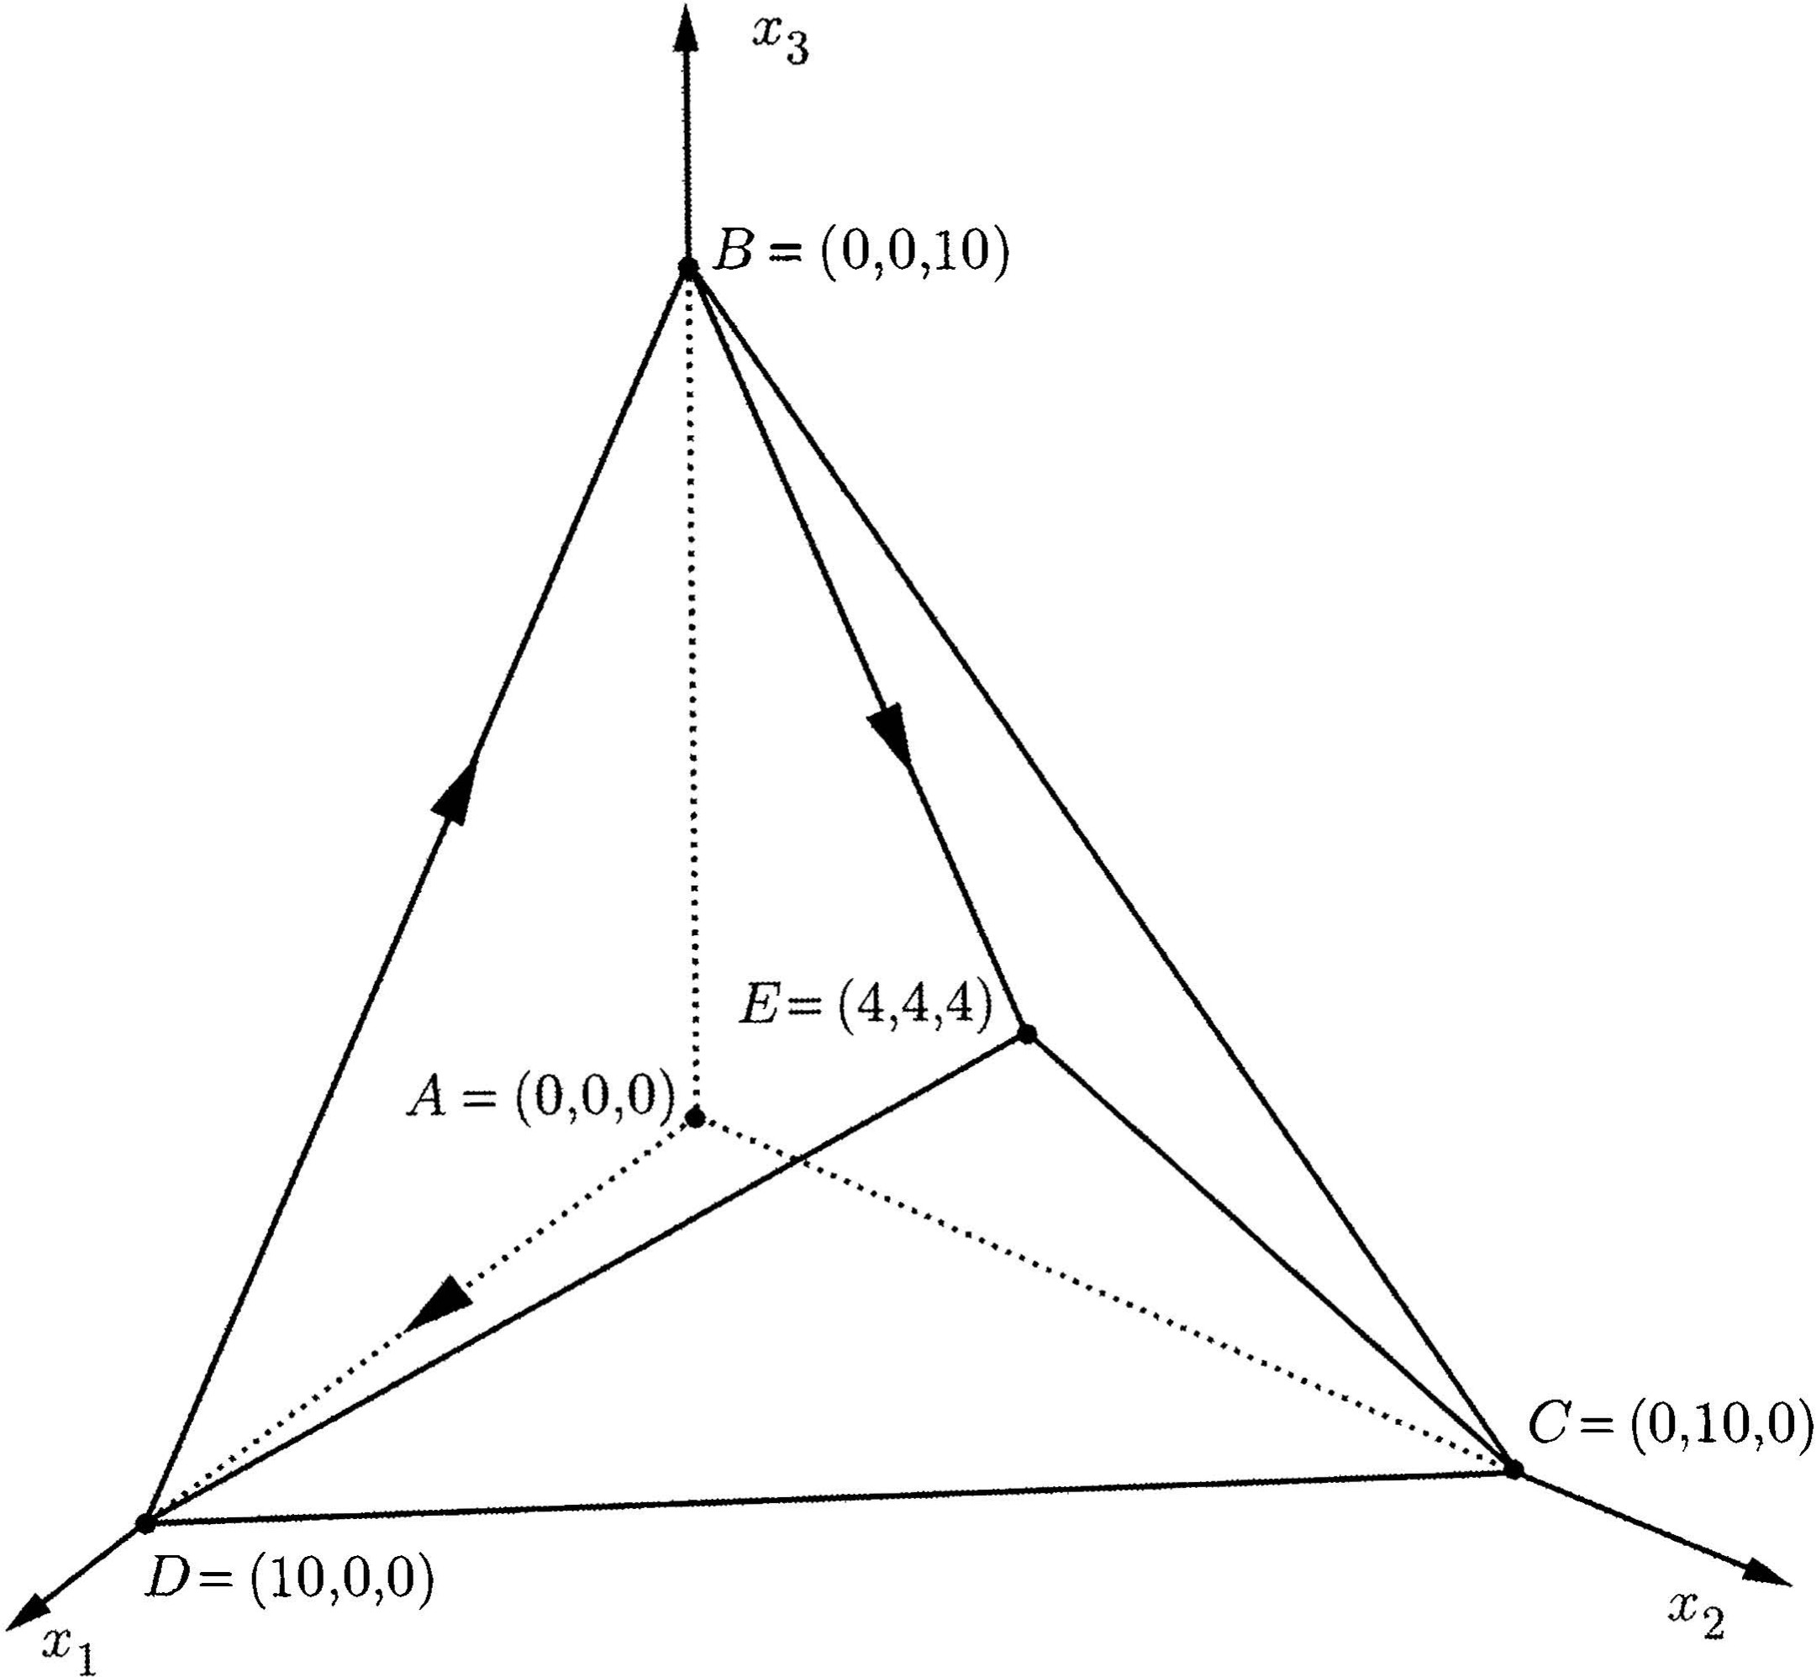
Example 3.5
minimize − 10x₁ − 12x₂ − 12x₃
subject to x₁ + 2x₂ + 2x₃ ≤ 20
2x₁ + x₂ + 2x₃ ≤ 20
2x₁ + 2x₂ + x₃ ≤ 20
x₁, x₂, x₃ ≥ 0.

Slide 97
Example 3.5
After introducing slack variables, we obtain the standard form problem
minimize − 10x₁ − 12x₂ − 12x₃
subject to x₁ + 2x₂ + 2x₃ + x₄ = 20
2x₁ + x₂ + 2x₃ + x₅ = 20
2x₁ + 2x₂ + x₃ + x₆ = 20
x₁, x₂, x₃, x₄, x₅, x₆ ≥ 0.
minimize − 10x₁ − 12x₂ − 12x₃
subject to x₁ + 2x₂ + 2x₃ ≤ 20
2x₁ + x₂ + 2x₃ ≤ 20
2x₁ + 2x₂ + x₃ ≤ 20
x₁, x₂, x₃ ≥ 0.

Slide 98
Example 3.5
After introducing slack variables, we obtain the standard form problem
minimize − 10x₁ − 12x₂ − 12x₃
subject to x₁ + 2x₂ + 2x₃ + x₄ = 20
2x₁ + x₂ + 2x₃ + x₅ = 20
2x₁ + 2x₂ + x₃ + x₆ = 20
x₁, x₂, x₃, x₄, x₅, x₆ ≥ 0.
▶ Note that x = (0, 0, 0, 20, 20, 20) is a basic feasible solution and can be used to start the algorithm.
▶ Let accordingly, B(1) = 4, B(2) = 5, and B(3) = 6.
▶ The corresponding basis matrix is the identity matrix I.
▶ To obtain the zeroth row of the initial tableau, we note that
c = 0 and, therefore, c x = 0 and ¯
′ ′ ′ ′ −1
′
B
B
c = c − c B A = c .
B
B
▶ Hence, we have the following initial tableau:

Slide 99
Example 3.5: Initial tableau
x₁
x₂ x₃ x₄ x₅ x₆
0 | −10 | −12 | −12 | 0 | 0 | 0
20 | 1 | 2 | 2 | 1 | 0 | 0
20 | 2 | 1 | 2 | 0 | 1 | 0
20 | 2 | 2 | 1 | 0 | 0 | 1
x₄ = x₅ = x₆ =

Slide 100
Example 3.5: Initial tableau
x₁
x₂ x₃ x₄ x₅ x₆
0 | −10 | −12 | −12 | 0 | 0 | 0
20 | 1 | 2 | 2 | 1 | 0 | 0
20 | 2 | 1 | 2 | 0 | 1 | 0
20 | 2 | 2 | 1 | 0 | 0 | 1
x₄ = x₅ = x₆ =
We note a few conventions in the format of the above tableau:
▶ The label x_{i} on top of the ith column indicates the variable associated with that column.
▶ The labels “x_{i} =” to the left of the tableau tell us which are the basic variables and in what order:
▶ x_{B(1)} = x₄ = 20,
▶ x_{B(2)} = x₅ = 20,
▶ x_{B(3)} = x₆ = 20.

Slide 101
Example 3.5: Initial tableau
x₁
x₂ x₃ x₄ x₅ x₆
0 | −10 | −12 | −12 | 0 | 0 | 0
20 | 1 | 2 | 2 | 1 | 0 | 0
20 | 2 | 1 | 2 | 0 | 1 | 0
20 | 2 | 2 | 1 | 0 | 0 | 1
x₄ = x₅ = x₆ =
We note a few conventions in the format of the above tableau:
▶ These labels are not necessary.
▶ We know that the column in the tableau associated with the first basic variable must be the first unit vector.
▶ Once we observe that the column associated with the variable x₄ is the first unit vector, it follows that x₄ is the first basic variable.

Slide 102
Example 3.5: Initial tableau
x₁ x₂ x₃ x₄ x₅ x₆
x₄ = x₅ = x₆ =
We continue with our example.
▶ The reduced cost of x₁ is negative and we let that variable enter the basis.
▶ The pivot column is u = (1, 2, 2).
▶ We form the ratios x_{B(i)}/u_{i}, i = 1, 2, 3:
▶ x_{B(1)}/u₁ = 20/1 = 20,
▶ x_{B(2)}/u₂ = 20/2 = 10,
▶ x_{B(3)}/u₃ = 20/2 = 10.
▶ The smallest ratio corresponds to i = 2 and i = 3.
▶ We break this tie by choosing ℓ = 2.
0 | −10 | −12 | −12 | 0 | 0 | 0
 | 1
20 |  | 2 | 2 | 1 | 0 | 0
20 | 2 | 1 | 2 | 0 | 1 | 0
20 | 2 | 2 | 1 | 0 | 0 | 1

Slide 103
Example 3.5: Initial tableau
x₂ x₃ x₄ x₅ x₆
 | x₁ −10 1
0 |  | −12 | −12 | 0 | 0 | 0
20 20 20 |  | 2 | 2 | 1 | 0 | 0
 | 2 | 1 | 2 | 0 | 1 | 0
 | 2 | 2 | 1 | 0 | 0 | 1
x₄ = x₅ = x₆ =
▶ The second basic variable x_{B(2)}, which is x₅, exits the basis.
This determines the and the pivot element.
pivot row
▶ The new basis is given by B¯(1) = 4, B¯(2) = 1, and
B¯(3) = 6.

Slide 104
Example 3.5: Initial tableau
x₂ x₃ x₄ x₅ x₆
 | x₁ −10 1
0 |  | −12 | −12 | 0 | 0 | 0
20 20 20 |  | 2 | 2 | 1 | 0 | 0
 | 2 | 1 | 2 | 0 | 1 | 0
 | 2 | 2 | 1 | 0 | 0 | 1
x₄ = x₅ = x₆ =
▶ We multiply the pivot row by 5 and add it to the zeroth row.
▶ We multiply the pivot row by 1/2 and subtract it from the first row.
▶ We subtract the pivot row from the third row.
▶ Finally, we divide the pivot row by 2.
▶ This leads us to the new tableau:

Slide 105
Example 3.5: First pivot
x₁ x₂ x₃ x₄
x₅ x₆
100 | 0 | −7 | −2 | 0 | 5 | 0
10 | 0 | 1.5 | 1 | 1 | −0.5 | 0
10 | 1 | 0.5 | 1 | 0 | 0.5 | 0
0 | 0 | 1 | −1 | 0 | −1 | 1
x₄ = x₁ = x₆ =
▶ The cost has been reduced to −100.
▶ The corresponding basic feasible solution is
x = (10, 0, 0, 10, 0, 0).
▶ Note that this is a degenerate basic feasible solution, because the basic variable x₆ is equal to zero.

Slide 106
Example 3.5: First pivot
x₁ x₂ x₃ x₄
x₅ x₆
100 | 0 | −7 | −2 | 0 | 5 | 0
10 | 0 | 1.5 | 1 | 1 | −0.5 | 0
10 | 1 | 0.5 | 1 | 0 | 0.5 | 0
0 | 0 | 1 | −1 | 0 | −1 | 1
x₄ = x₁ = x₆ =
▶ In terms of the original variables x₁, x₂, x₃, we have moved to the degenerate solution D = (10, 0, 0).

Slide 107
Example 3.5: First pivot
x₁ x₂ x₃ x₄
x₅ x₆
100 | 0 | −7 | −2 | 0 | 5 | 0
10 | 0 | 1.5 | 1 | 1 | −0.5 | 0
10 | 1 | 0.5 | 1 | 0 | 0.5 | 0
0 | 0 | 1 | −1 | 0 | −1 | 1
x₄ = x₁ = x₆ =
▶ We have mentioned earlier that the rows of the tableau (other than the zeroth row) amount to a representation of the equality constraints B⁻¹Ax = B⁻¹b, which are equivalent to the original constraints Ax = b.
▶ In our current example, the tableau indicates that the equality constraints can be written in the equivalent form:
10 = 1.5x₂ +x₃ +x₄ −0.5x₅
10 = x₁ +0.5x₂ +x₃
0 = x₂ −x₃
+0.5x₅
−x₅ +x₆.

Slide 108
Example 3.5: First pivot
x₁
x₂ x₃ x₄ x₅ x₆
100 | 0 | −7 | −2 | 0 | 5 | 0
 |  |  | 1
10 | 0 | 1.5 |  | 1 | −0.5 | 0
10 | 1 | 0.5 | 1 | 0 | 0.5 | 0
0 | 0 | 1 | −1 | 0 | −1 | 1
x₄ = x₁ = x₆ =
▶ We now return to the simplex method.
▶ With the current tableau, the variables x₂ and x₃ have negative reduced costs.
▶ We choose x₃ to be the one that enters the basis.
▶ The pivot column is u = (1, 1, −1).
▶ Since u₃ < 0, we only form the ratios x_{B(i)}/u_{i}, for i = 1, 2:
▶ x_{B(1)}/u₁ = 10/1 = 10,
▶ x_{B(2)}/u₂ = 10/1 = 10.
▶ There is again a tie, which we break by letting ℓ = 1.

Slide 109
Example 3.5: First pivot
x₁ x₂
x₄ x₅ x₆
 |  |  | x₃
 |  |  | −2
100 10 | 0 0 | −7 1.5 |  | 0 | 5 | 0
 |  |  | 1 | 1 | −0.5 | 0
10 | 1 | 0.5
 |  |  | 1 | 0 | 0.5 | 0
0 | 0 | 1 | −1 | 0 | −1 | 1
x₄ = x₁ = x₆ =
▶ The first basic variable, x₄, exits the basis.
This determines the and the pivot element.
pivot row
▶ We multiply the pivot row by 2 and add it to the zeroth row.
▶ We subtract the pivot row from the second row.
▶ Finally, we add the pivot row to the third row.
▶ We obtain the following new tableau:

Slide 110
Example 3.5: Second pivot
x₁ x₂
x₃ x₄ x₅ x₆
120 | 0 | −4 | 0 | 2 | 4 | 0
10 | 0 | 1.5 | 1 | 1 | −0.5 | 0
0 | 1 | −1 | 0 | −1 | 1 | 0
10 | 0 | 2.5 | 0 | 1 | −1.5 | 1
x₃ = x₁ = x₆ =
▶ The cost has been reduced to −120.
▶ The corresponding basic feasible solution is
x = (0, 0, 10, 0, 0, 10).

Slide 111
Example 3.5: Second pivot
x₁ x₂
x₃ x₄ x₅ x₆
120 | 0 | −4 | 0 | 2 | 4 | 0
10 | 0 | 1.5 | 1 | 1 | −0.5 | 0
0 | 1 | −1 | 0 | −1 | 1 | 0
10 | 0 | 2.5 | 0 | 1 | −1.5 | 1
x₃ = x₁ = x₆ =
▶ In terms of the original variables x₁, x₂, x₃, we have moved to point B = (0, 0, 10).

Slide 112
Example 3.5: Second pivot
x₁ x₂
x₃ x₄ x₅ x₆
120 | 0 | −4 | 0 | 2 | 4 | 0
 |  | 1.5
10 | 0 |  | 1 | 1 | −0.5 | 0
0 | 1 | −1 | 0 | −1 | 1 | 0
10 | 0 | 2.5 | 0 | 1 | −1.5 | 1
x₃ = x₁ = x₆ =
▶ At this point, x₂ is the only variable with negative reduced cost.
▶ We bring x₂ into the basis.
▶ The pivot column is u = (1.5, −1, 2.5).
▶ Since u₂ < 0, we only form the ratios x_{B(i)}/u_{i}, for i = 1, 3:
▶ x_{B(1)}/u₁ = 10/1.5 = 6.¯6,
▶ x_{B(3)}/u₃ = 10/2.5 = 4.
▶ We obtain ℓ = 3, and the third basic variable, x₆ exits the basis.

Slide 113
Example 3.5: Second pivot
x₁
x₃ x₄ x₅ x₆
 |  | x₂ −4 1.5 −1
120 | 0 |  | 0 | 2 | 4 | 0
10 0 10 | 0 1 0 |  | 1 0 | 1 −1 | −0.5 1 | 0 0
 |  | 2.5 | 0 | 1 | −1.5 | 1
x₃ = x₁ = x₆ =
▶ This determines the and the pivot element.
pivot row
▶ We multiply the pivot row by 4/2.5 and add it to the zeroth row.
▶ We multiply the pivot row by 1.5/2.5 and subtract it to the first row.
▶ We multiply the pivot row by 1/2.5 and add it to the second row.
▶ Finally, we divide the pivot row by 2.5.
▶ We obtain the following new tableau:

Slide 114
Example 3.5: Third pivot
x₁ x₂
x₃ x₄ x₅ x₆
136 | 0 | 0 | 0 | 3.6 | 1.6 | 1.6
4 | 0 | 0 | 1 | 0.4 | 0.4 | −0.6
4 | 1 | 0 | 0 | −0.6 | 0.4 | 0.4
4 | 0 | 1 | 0 | 0.4 | −0.6 | 0.4
x₃ = x₁ = x₂ =
▶ The cost has been reduced to −136.
▶ The corresponding basic feasible solution is
x = (4, 4, 4, 0, 0, 0).

Slide 115
Example 3.5: Third pivot
x₁ x₂
x₃ x₄ x₅ x₆
136 | 0 | 0 | 0 | 3.6 | 1.6 | 1.6
4 | 0 | 0 | 1 | 0.4 | 0.4 | −0.6
4 | 1 | 0 | 0 | −0.6 | 0.4 | 0.4
4 | 0 | 1 | 0 | 0.4 | −0.6 | 0.4
x₃ = x₁ = x₂ =
▶ In terms of the original variables x₁, x₂, x₃, we have moved to point E = (4, 4, 4).

Slide 116
Example 3.5: Third pivot
x₁ x₂
x₃ x₄ x₅ x₆
136 | 0 | 0 | 0 | 3.6 | 1.6 | 1.6
4 | 0 | 0 | 1 | 0.4 | 0.4 | −0.6
4 | 1 | 0 | 0 | −0.6 | 0.4 | 0.4
4 | 0 | 1 | 0 | 0.4 | −0.6 | 0.4
x₃ = x₁ = x₂ =
▶ The optimality of this solution is confirmed by observing that all reduced costs are nonnegative.

Slide 117
Example 3.5
▶ In this example, the simplex method took three changes of basis to reach the optimal solution, and it traced the path A − D − B − E.
▶ With different pivoting rules, a different path would have been traced.

Slide 118
Example 3.5
▶ Question: Could the simplex method have solved the problem by tracing the path A − D − E, which involves only two edges, with only two iterations?

